Slide 1
Auditing and Logging
Security 2018

Slide 2
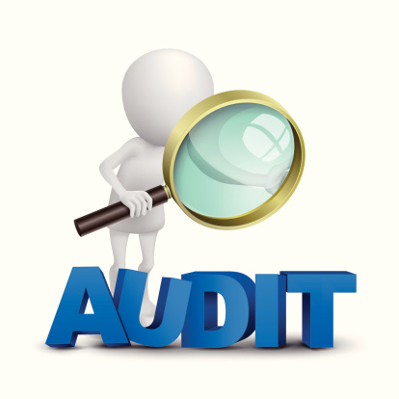
What is Auditing ?
An information security audit occurs when a technology team conducts an organizational
review to ensure that the correct and most up-to-date processes and infrastructure are being applied.

Slide 3
What is Auditing ?
When auditing you try to discover what is really going on
for example:
- Find security issues (outdated software, poor security, etc.)
- Evaluate systems, processes, risks and controls
- Enable people to make informed decisions

Slide 4
How do you discover what is really going on in a network ?
Identify the topology of the network
Identify all hosts on the network
Determine services running on all hosts
The configuration of all services and applications on the host
Look at logs
Logs: An audit log is a document that records an event in an information technology system.

Slide 5
What is logging ?
A log is a record of sequential data such as:
    Audit logs
    Transaction logs
    Connections logs
And generated by :
    Operating system
    Databases
    Firewalls
    Antivirus
    Routers

Slide 6
Vulnerabilities:
An application is deemed to be potentially vulnerable if there is insufficient logging and auditing, detection, and monitoring, with effective responses.
Areas where a lack of logging is potentially dangerous to your environment include:
    Warnings and errors that are not logged, or warnings and errors that produce no meaningful output.
    Ambiguous and unclear logs are also not helpful to system administrators and developers.
    Auditable events such as user logins, failed login attempts, and unlogged activities
    such as high-value transactions and system related changes.

Slide 7
Vulnerabilities: cont..
    Important logs of critical applications and APIs are overlooked when auditing and system logs are set up, meaning that entire systems can go on without ever being monitored, causing massive potential for security breaches in critical IT systems.
    Logs being stored only locally gives intruders an opportunity to edit the logs and remove any evidence of their activities in your environment.
    Alerts and responses that are not implemented correctly, or at all.
    Applications might not have ant detection, logging or alerting systems built into them, meaning that attacks go unnoticed by system administrators.

Slide 8
Benefits of Auditing and logging:
Logging user actions can help [companies] improve security in a variety of ways
because it provides a way for administrators to reconstruct events, detect
intrusions, and analyze problems such as poor performance or unexpected
system behavior. The following includes other ways audit logging can reinforce
an enterprise’s security. Next slide
Documenting what resources were accessed, audit log entries
usually include destination and source addresses, a timestamp and user
login information.
Security logs and reports provide you with an electronic record of
suspicious activities and help you detect patterns that may
indicate attempted or successful external penetration of the
network, as well as internal attacks.

Slide 9
Benefits of Auditing and logging: cont..
ways audit logging can reinforce an enterprise’s security:
Detect Security Breaches:
    Having detailed audit logs helps companies monitor data and keep track of potential security breaches or internal misuses of information
Assess System Damages:
    Audit trails can be used to reconstruct events after a problem has occurred. Damage can be more easily assessed by reviewing audit trails of system activity to pinpoint how, when, and why normal operations ceased.

Slide 10
Benefits of Auditing and logging: cont..
ways audit logging can reinforce an enterprise’s security:
Aid in Recovery Processes:
    Understanding how and why a system crash or an intrusion occurred is pertinent to avoiding similar outcomes in the future. Audit logs can help in situations regarding data loss or corruption by allowing administrators to reconstruct data files through the changes recorded in the logs.

Slide 11
Benefits of Auditing and logging: cont..
Protect data by maintaining visibility and responding quickly to
timely security alerts.
Auditing and logging of security-related events, and related alerts,
are important components in an effective data protection .
you can use auditing to monitor user activity.
Alerts provide immediate notification when security events occur.

Slide 12
Examples:
Microsoft business services and products provide you with
configurable security auditing and logging options to help you
identify gaps in your security policies and mechanisms and
address those gaps to help prevent breaches.
Microsoft services offer some (and in some cases, all) of the
following options: centralized monitoring, logging, and analysis
systems to provide continuous visibility; timely alerts; and reports
to help you manage the large amount of information generated
by devices and services

Slide 13
References:
https://www.microsoft.com/en-us/trustcenter/security/auditingandlogging?fbclid=IwAR2VZAcqwI4yOaVFDEdRRahau6nU5wTiQqmw9Ow_UAdFVk_R8efqM3w2WLI
https://www.digicert.com/blog/the-security-benefits-of-audit-logging/
https://www.techopedia.com/definition/10236/information-security-audit
http://www3.kau.se/kurstorg/files/a/55E2E9B11d97b3115AKOFF962F40/Audit&Logs.pdf

